Slide 1
Time Series Unobserved Components Models

Slide 2
Nature of UCM Models
UCM models are also sometimes called structural time series models and are very handy models when you have a complicated time series to model that involves trend and seasonal components. The SAS manual describes UCM models as good models in that they “capture the versatility of the ARMA models while possessing the interpretability of the smoothing models”. They are a good strategy for forecasting complex time series.
UCM models are really quite versatile and allow you to capture complex trend and seasonal patterns in the data without a lot of specification. You can either let SAS deal with the complex details itself or you can tweak any of the parameters if you have an idea of the nature of the underlying processes.

Slide 3
Nature of UCM Models
The Basic Structural Model (BSM) is the base fundamental model for UCM. It consists of four different components and they are estimated separately and then summed to form the model:
Trend or Slope component
Seasonal component
Irregular component
Random error or Level component

Slide 4
Nature of UCM Models
Each of the four components – trend, seasonality, irregular component and the random error – are considered to be independent processes and are by default treated as having variances that are defined by random walks that are estimated by the data.
What that means is that if the trend or slope varies over time or the seasonality varies over time, the irregular (ARMA) coefficients can vary over time and the random error component can vary over time. This means that you can model some pretty complex stuff and you don’t have to get uptight about having to specify parameters for each

Slide 5
Nature of UCM Models
As we said in the previous slide, the four different processes can vary over time and the amount that they can vary is determined by estimating the variance in each of the four processes using the data at hand and assuming that a random walk process is at work at any time point in the time series.
However, if for theoretical or prior knowledge reasons you feel that you know something about the variances in these processes, you can specify the NOEST and VARIANCE= parameters that tell SAS not to estimate the variance in the processes from the data but from the parameters that follow. You should have cajones of steel for this.

Slide 6
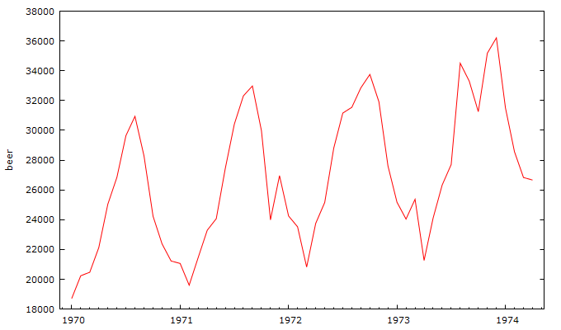
UCM Example - Beer
Here is our favorite beer plot

Slide 7
UCM Example - Beer
We know that this time series data has the following going on:
Trend
Seasonality
ARMA processes
Random error

Slide 8
UCM Example – SAS Code
proc ucm data=temp;
id mytime interval = day ; specify the id variable and interval
model beer ; tell SAS to model the time series variable beer
irregular; Tell SAS there is an irregular component (random walk)
level; Tell SAS there is an error component (random walk)
slope; Tell SAS there is a trend component (random walk)
cycle; Tell SAS there is a seasonal component (random walk)
Forecast lead = 24 plot=decomp; forecast 24 periods and plot processes separately;
run;

Slide 9
UCM Output
UCM spits out a lot of output. A summary of the output is in the pdf embedded in this slide deck.

Slide 10
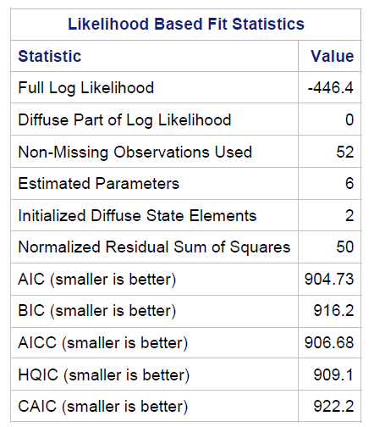
UCM Output – the Important Stuff
Here are some usual goodness of fit statistics for comparing models

Slide 11
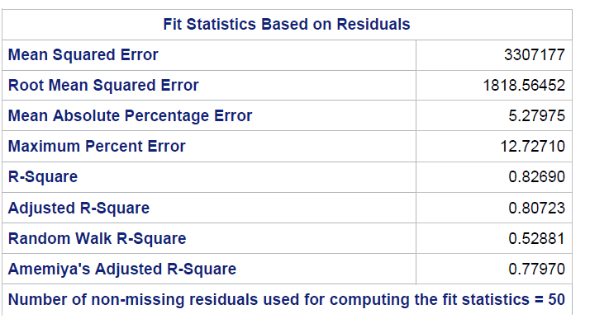
UCM Output – the Important Stuff
Here are some additional goodness of fit statistics

Slide 12
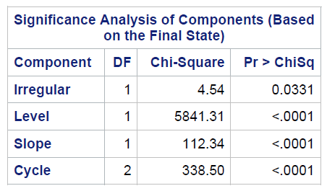
UCM Output – the Important Stuff
Here are the p values for each of the four components

Slide 13
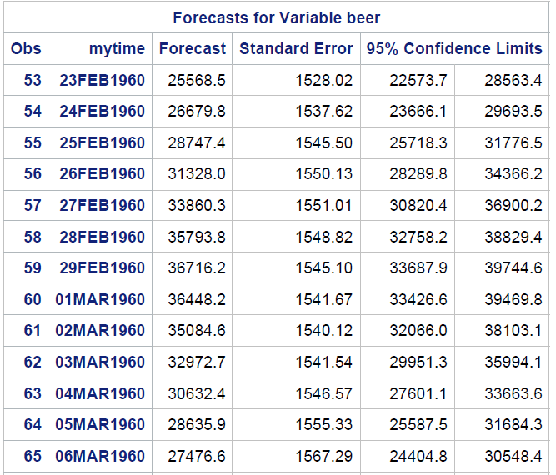
UCM Output – the Important Stuff
Here are some of the forecasts…

Slide 14
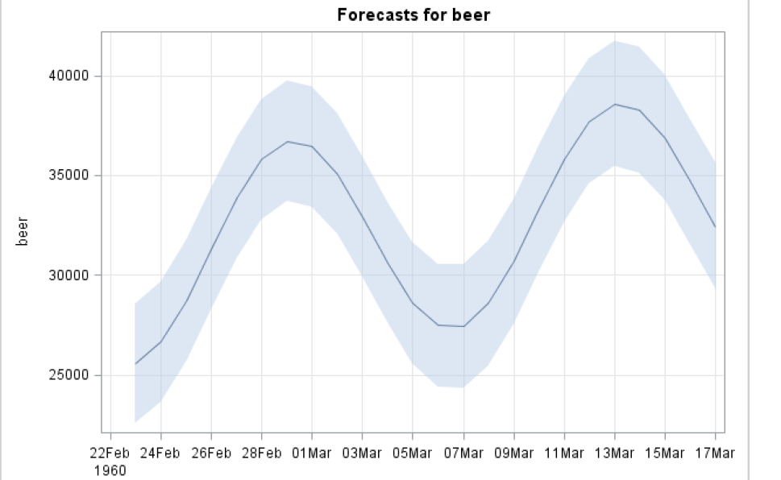
UCM Output – the Important Stuff
Here is the forecast plot

Slide 15
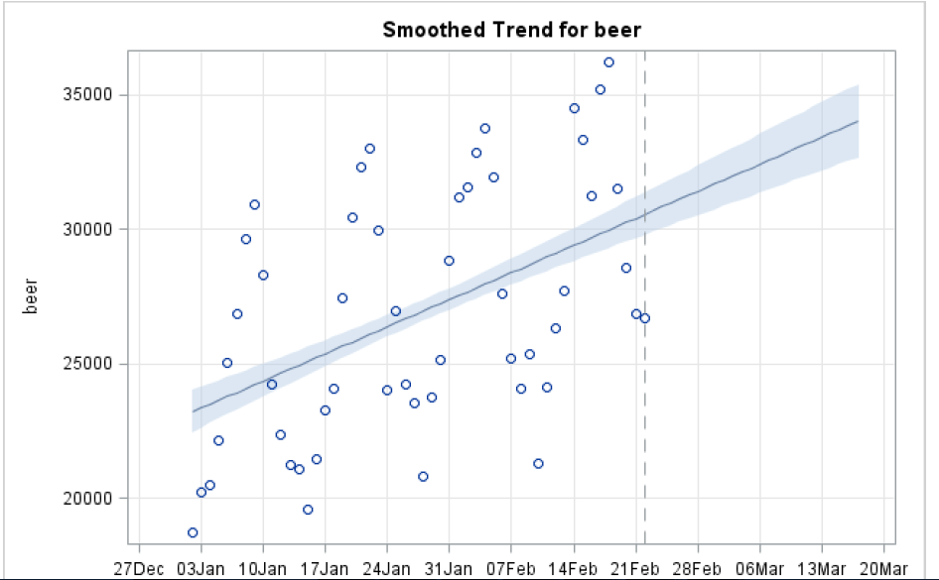
UCM Output – the Important Stuff
Here is the forecast plot for the trend component

Slide 16
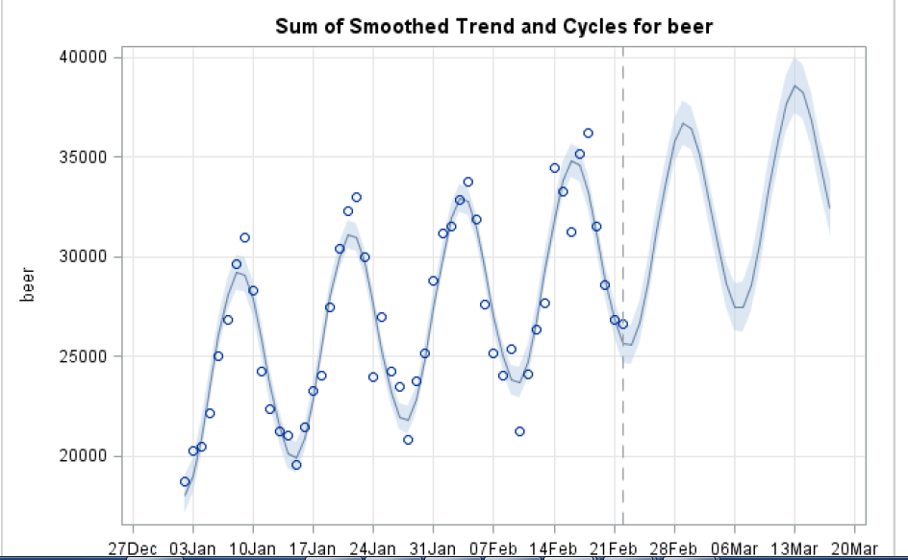
UCM Output – the Important Stuff
Here is the forecast plot for the seasonal component

